Slide 1
EPA143A: Economic Foundations Week 1: Introduction Macro-Economics
The purpose of Lecture Note W1 is to introduce you to important macro-economic concepts/variables.
Most macro-economic variables are defined in the national accounts. These national accounts are the macroeconomic depiction of the national ‘circular flow of income’, using the double-entry bookkeeping principle and a sequence of accounts to show the relationship between the various economic variables.
The national accounts, in turn, are based on the input-output table, which records all transactions in the real economy. The starting point of the IO table is the following accounting identity:
total supply of goods & services = total demand for goods & services

Slide 2
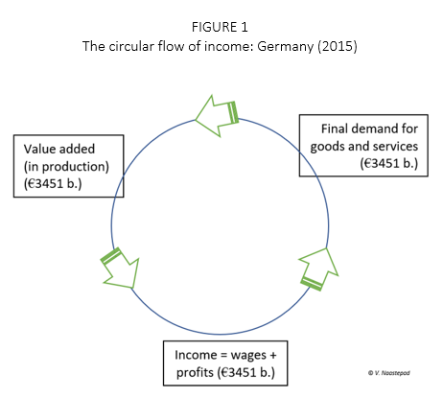
EPA143A: Economic Foundations Week 1: Circular Flow of Income
The circular flow of income
is at the heart of any
macro-economic model;
it describes the process of
production of goods & services
→ employment →
income generation (and income
distribution and redistribution)
→ demand for goods & services
(based on income)
→ production etc.

Slide 3
EPA143A: Economic Foundations Week 1: Gross Domestic Product
Input-Output Table:
GDP = sum of industry value added = 720 (estimated based on costs)
GDP = final demand = 720 (estimated based on final demand)
 | agriculture | industry | Services | Final demand | Total demand
Agriculture | 40 | 30 | 30 | 120 | 220
Industry | 20 | 100 | 30 | 250 | 400
Services | 10 | 70 | 20 | 350 | 450
Value-added | 150 | 200 | 370 | - | 720
Gross output (supply) | 220 | 400 | 450 | 720 | -

Slide 4
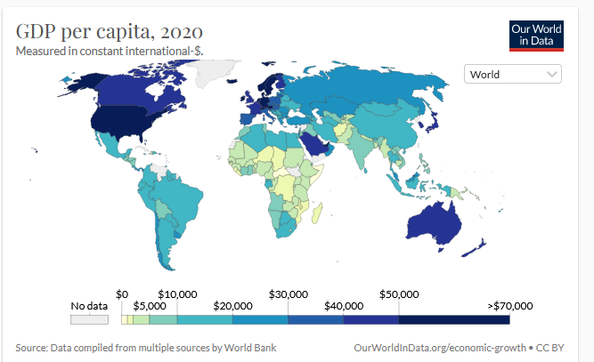
EPA143A: Economic Foundations Week 1: GDP per capita = indicator of living standards
Lowest $600 per year
Highest $ 66000 per
year
Ratio: 1 : 110

Slide 5
EPA143A: Economic Foundations Week 1: Final Demand for goods & services
Final demand = C + G + I + E – M
C = private consumption demand (by households)
G = current expenditure by the government
I = investment demand (by firms and the state)
E = export demand (= demand by Rest of World)
M = import demand
Note that if E > M -> trade balance surplus; if E < M -> trade balance deficit

Slide 6
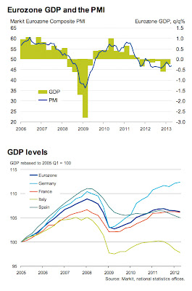
EPA143A: Economic Foundations Week 1: recession
Recessions are defined
as two consecutive
quarters of negative
economic growth,
as measured by
the quarter-on-quarter
figures for real GDP
(after seasonal adjustment).

Slide 7
EPA143A: Economic Foundations Week 1: Nominal versus real GDP
Nominal GDP = real GDP x general price level (P)
or
Real GDP = nominal GDP / general price level (P)
Hence (by approximation):
Growth rate of real GDP = growth rate of nominal GDP – inflation rate
1% = 2.2% – 1.2%

Slide 8
EPA143A: Economic Foundations Week 1: Nominal versus real GDP
Suppose your nominal income is € 2000 per month in 2021.
We assume that the general price level P = 1.00 in 2021.
Inflation is expected to be 6% in 2022. The expected price level in 2022 is 1.06. Your nominal income will increase by 3% in 2021 – to € 2060 per month.
What will happen to your real income per month?
Your monthly real income will decline: € 2060/1.06 = € 1943, 40.

Slide 9
EPA143A: Economic Foundations Week 1: Nominal versus real GDP
Nominal GDP (blue line)
versus real GDP (orange
line) of the Netherlands
(1960-2020) at 1960
(constant) prices
(in 1960 P = 1.00)
P increases from 1.00 in 1960
to 13.60 in 2020. Average annual inflation = 4.4%

Slide 10
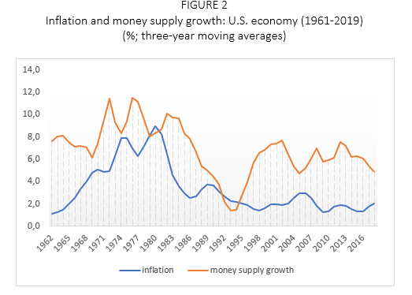
EPA143A: Economic Foundations Week 1: Inflation and money supply growth
No clear link between
inflation and the growth
of money supply .....

Slide 11
EPA143A: Economic Foundations Week 1: Unemployment
The official unemployment rate (known as U-3) is defined as the number of unemployed persons as a share (or a percentage) of the total active population (= the labour force).
The labour force is the number of people (in the age bracket 16-65 years) employed and unemployed.
Persons in employment are those who during the reference week did any work for pay, or were not working but had jobs from which they were temporarily absent.
Note: discouraged workers and/or persons marginally attached to the labour force.

Slide 12
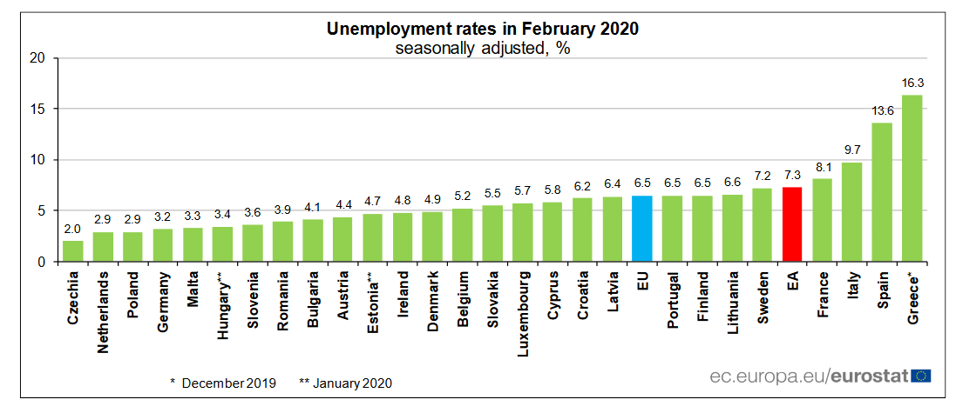
EPA143A: Economic Foundations Week 1: E.U. Unemployment rates Feb. 2020

Slide 13
EPA143A: Economic Foundations Week 1: Macro-economic policy instruments
Macro-economic policy
Fiscal policy: government
Public investment
Public current spending
Direct and indirect taxation; subsidies
Monetary policy:
central bank
Interest rate OR money supply

Slide 14
EPA143A: Economic Foundations Week 1: Fiscal policy
GDP = Y = C + G + Ip + Ig + (E – M) -- see the circular flow of income
G = government current spending
Ig = public investment
Fiscal stimulus (expansionary fiscal policy):
An increase in G or Ig will raise (final) demand, output and income (GDP). Or: a reduction in income taxation will increase private consumption C; demand, output and income (GDP) will rise.
Fiscal austerity: “bezuinigingen” (cuts in G, Ig; higher taxes)

Slide 15
EPA143A: Economic Foundations Week 1: Monetary policy by central banks
Interest rate: the central bank (ECB) will increase the interest rate to lower inflation; a higher interest rate reduces (investment) demand; economic growth goes down; inflation goes down.
Money supply: in the neoclassical model and the IS-LM it is assumed that the central bank can reduce inflation by directly lowering money supply. This is still a widespread view, but it is wrong (as we shall discuss later in the course).

Slide 16

EPA143A: Economic Foundations Week 1: The debt dynamics equation
$Δdebt=fiscal deficit+(i−g)×debt$
where $Δdebt=$ the change in the public debt-to-GDP ratio; the fiscal deficit (as a percentage of GDP) does not include interest payments; i = the nominal rate of interest; g = the growth of nominal GDP; and debt = the initial public debt-to-GDP ratio.
See the exercises.

